Slide 1
MEMORY MANAGEMENT Main Memory CS2006: OS -Fall 2021

Slide 2
BACKGROUND
Program must be brought (from disk) into memory and placed within a process for it to be run.
Main memory and registers are only storage CPU can access directly.
Memory unit only sees a stream of:
addresses + read requests, or
address + data and write requests
Register access is done in one CPU clock (or less).
Main memory can take many cycles, causing a stall.
Cache sits between main memory and CPU registers.
Protection of memory required to ensure correct operation

Slide 3
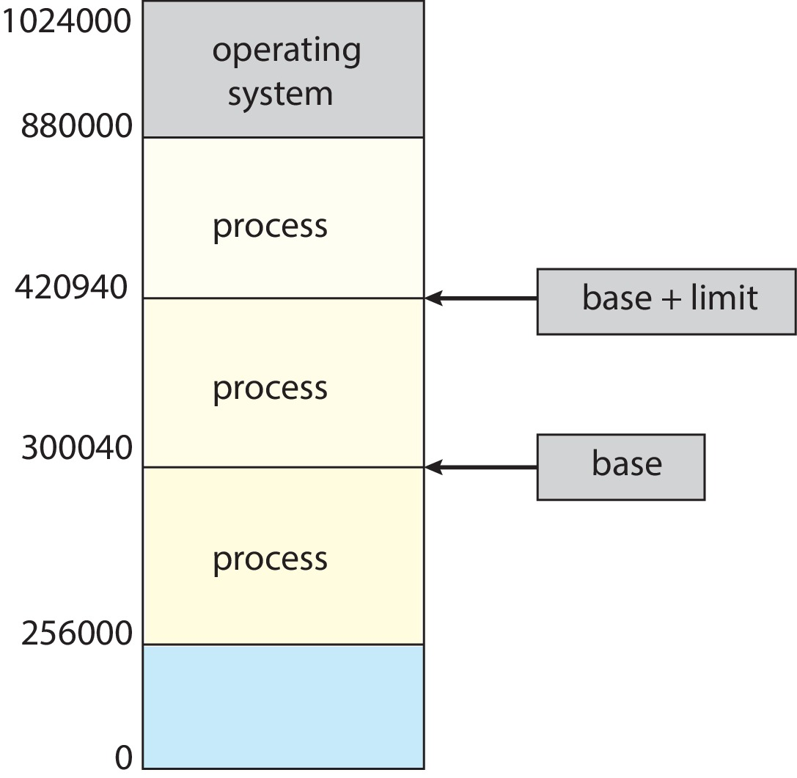
Base and Limit Registers
A pair of base and limit registers define the logical address space
CPU must check every memory access generated in user mode to be sure it is between base and limit for that user process.
Limit register = 120900

Slide 4
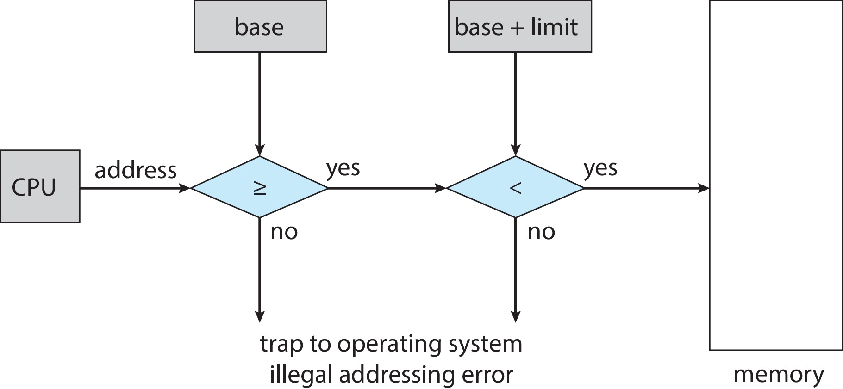
Hardware Address Protection
CPU must check every memory access generated in user mode to be sure it is between base and limit for that user
the instructions to loading the base and limit registers are privileged

Slide 5
Address Binding
Programs on disk, ready to be brought into memory to execute form an input queue
Without support, must be loaded into address 0000
Inconvenient to have first user process physical address always at 0000
How can it not be?
Addresses represented in different ways at different stages of a program’s life
Source code addresses usually symbolic
Compiled code addresses bind to relocatable addresses
i.e., “14 bytes from beginning of this module”
Linker or loader will bind relocatable addresses to absolute addresses
i.e., 74014
Each binding maps one address space to another

Slide 6
Binding of Instructions and Data to Memory
Address binding of instructions and data to memory addresses can happen at three different stages
Compile time: If memory location known a priori, absolute code can be generated; must recompile code if starting location changes.
Load time: Must generate relocatable code if memory location is not known at compile time.
Execution time: Binding delayed until run time if the process can be moved during its execution from one memory segment to another.
Need hardware support for address maps (e.g., base and limit registers)

Slide 7
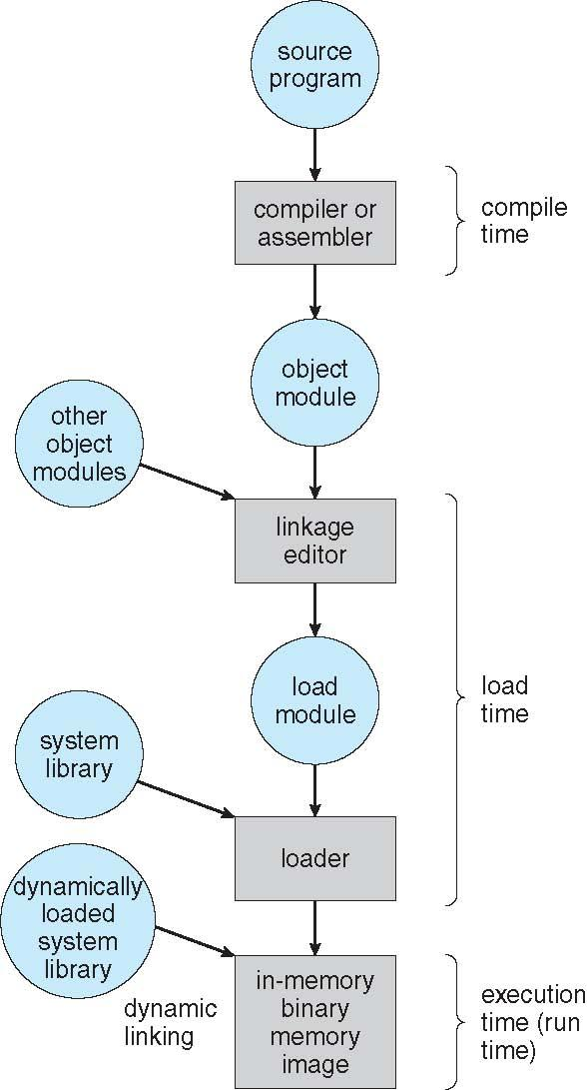
Multistep Processing of a User Program

Slide 8
Logical vs. Physical Address Space
The concept of a logical address space that is bound to a separate physical address space is central to proper memory management
Logical address – generated by the CPU; also referred to as virtual address
Physical address – address seen by the memory unit.
Logical and physical addresses are the same in compile-time and load-time address-binding schemes; logical (virtual) and physical addresses differ in execution-time address-binding scheme.
Logical address space is the set of all logical addresses generated by a program.
Physical address space is the set of all physical addresses generated by a program

Slide 9
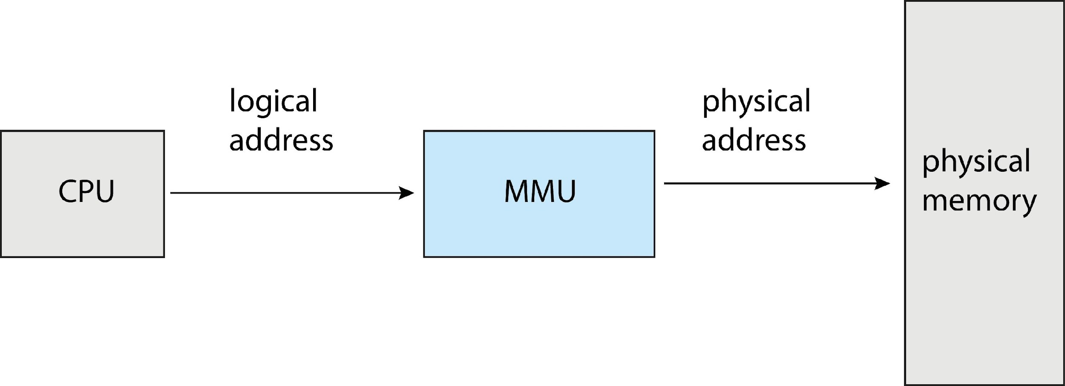
MEMORY-MANAGEMENT UNIT (MMU)
MMU is a hardware device that at run time maps virtual address to physical address
To start, consider simple scheme where the value in the relocation register is added to every address generated by a user process at the time it is sent to memory
Base register now called relocation register
MS-DOS on Intel 80x86 used 4 relocation registers
The user program deals with logical addresses; it never sees the real physical addresses
Execution-time binding occurs when reference is made to location in memory

Slide 10
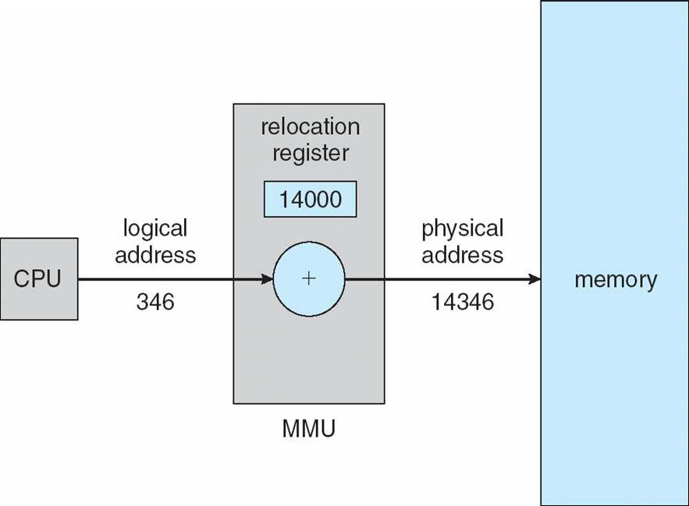
Dynamic relocation using a relocation register
Routine is not loaded until it is called
Better memory-space utilization; unused routine is never loaded
All routines kept on disk in relocatable load format
Useful when large amounts of code are needed to handle infrequently occurring cases
No special support from the operating system is required
Implemented through program design
OS can help by providing libraries to implement dynamic loading

Slide 11
STATIC & DYNAMIC LINKING
Static linking – system libraries and program code combined by the loader into the binary program image
Dynamic linking –linking postponed until execution time
Small piece of code, stub, used to locate the appropriate memory-resident library routine
Stub replaces itself with the address of the routine, and executes the routine
Dynamic linking is particularly useful for libraries

Slide 12
SWAPPING
A process can be swapped temporarily out of memory to a backing store, and then brought back into memory for continued execution
Total physical memory space of processes can exceed physical memory
Backing store – fast disk large enough to accommodate copies of all memory images for all users; must provide direct access to these memory images.
Roll out, roll in – swapping variant used for priority-based scheduling algorithms; lower-priority process is swapped out so higher-priority process can be loaded and executed.
Major part of swap time is transfer time; total transfer time is directly proportional to the amount of memory swapped.
System maintains a ready queue of ready-to-run processes which have memory images on disk

Slide 13
SWAPPING (Cont.)
Does the swapped-out process need to swap back in to same physical addresses?
Depends on address binding method
Plus consider pending I/O to / from process memory space
Modified versions of swapping are found on many systems (i.e., UNIX, Linux, and Windows)
Swapping normally disabled
Started if more than threshold amount of memory allocated
Disabled again once memory demand reduced below threshold

Slide 14
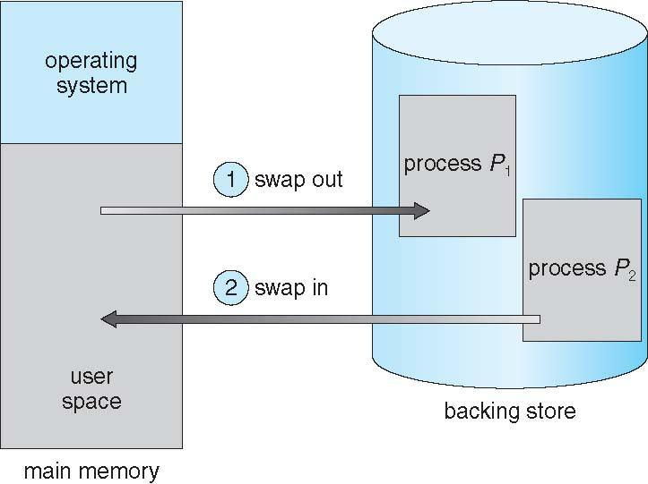
Schematic View of Swapping

Slide 15
Context Switch Time including Swapping
If next processes to be put on CPU is not in memory, need to swap out a process and swap in target process
Context switch time can then be very high
Problem:
100MB process swapping to hard disk with transfer rate of 50MB/sec from main memory.
Swap Time (sec) = Size (mb)/ transfer rate (mb/sec)
Swap Time = 100/50 = 2sec = 2000ms
Swap[out] time of 2000 ms
Plus, swap in of same sized process
Total context switch swapping component time = 4000ms (4 seconds)

Slide 16
Context Switch Time including Swapping (Cont.)
Constraints of Swapping:
Swap time can be reduced if reduce size of memory swapped – by knowing how much memory really being used
System calls to inform OS of memory use via request memory() and release memory()
Other constraints are:
Pending I/O – can’t swap out as I/O would occur to wrong process
always transfer I/O to kernel space, then to I/O device
  Known as double buffering, adds overhead
Standard swapping not used in modern operating systems
  Swap only when free memory extremely low

Slide 17
Swapping on Mobile Systems
Not typically supported
Flash memory based
Small amount of space
Limited number of write cycles
Poor throughput between flash memory and CPU on mobile platform
Instead use other methods to free memory if low
iOS asks apps to voluntarily relinquish allocated memory
Read-only data thrown out and reloaded from flash if needed
Failure to free can result in termination
Android terminates apps if low free memory, but first writes application state to flash for fast restart

Slide 18
CONTIGUOUS ALLOCATION
Main memory must support both OS and user processes
Limited resource, must allocate efficiently
Contiguous allocation is one early method
Main memory usually into two partitions:
Resident operating system, usually held in low memory with interrupt vector
User processes then held in high memory
Each process contained in single contiguous section of memory

Slide 19
Contiguous Allocation (Cont.)
Relocation registers used to protect user processes from each other, and from changing operating-system code and data
Base register contains value of smallest physical address
Limit register contains range of logical addresses – each logical address must be less than the limit register
MMU maps logical address dynamically
Can then allow actions such as kernel code being transient and kernel changing size

Slide 20
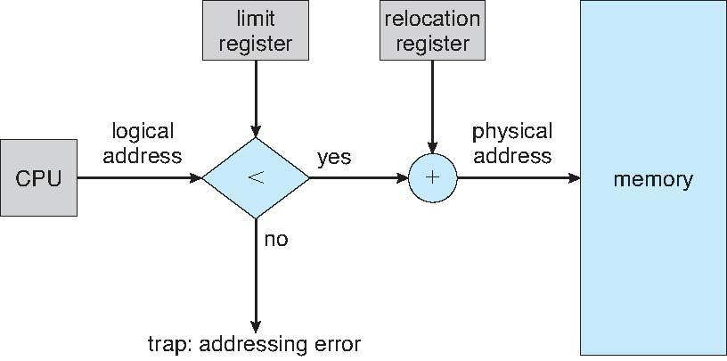
Hardware Support for Relocation and Limit Registers

Slide 21
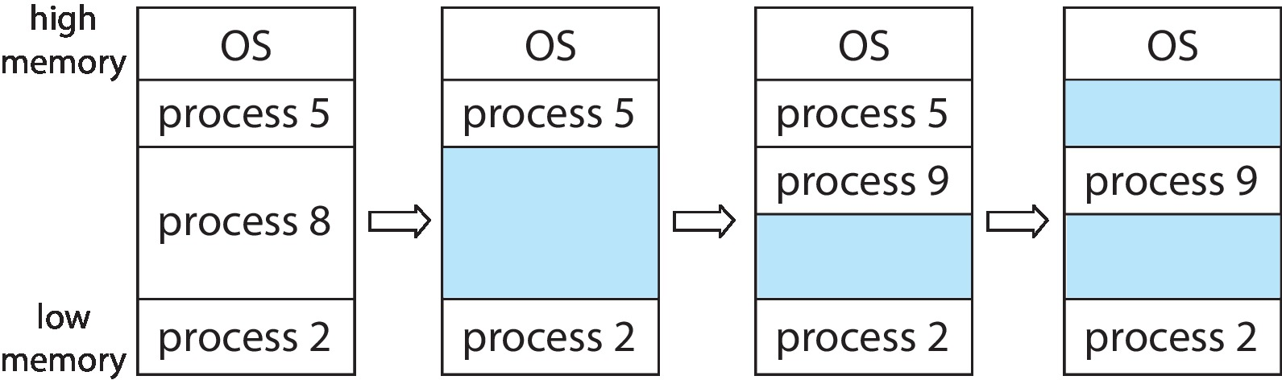
Variable Partition
Multiple-partition allocation
Degree of multiprogramming limited by number of partitions
Variable-partition sizes for efficiency (sized to a given process’ needs)
Hole – block of available memory; holes of various size are scattered throughout memory
When a process arrives, it is allocated memory from a hole large enough to accommodate it
Process exiting frees its partition, adjacent free partitions combined
Operating system maintains information about: a) allocated partitions b) free partitions (hole)

Slide 22
Dynamic Storage-Allocation Problem
First-fit: First Fit fits data into memory by scanning from the beginning of available memory to the end, until the first free space which is at least big enough to accept the data is found. This space is then allocated to the data. Any left over becomes a smaller, separate free space.
Best-fit: The best fit deals with allocating the smallest free partition which meets the requirement of the requesting process. This algorithm first searches the entire list of free partitions and considers the smallest hole that is adequate. It then tries to find a hole which is close to actual process size needed.
Worst-fit: The algorithm searches for free-space in memory in which it can store the desired information. The algorithm selects the largest possible free space that the information can be stored on (i.e. that is bigger than the information needing to be stored) and stores it there.
First-fit and best-fit better than worst-fit in terms of speed and storage utilization

Slide 23
Dynamic Storage-Allocation Problem
Given five memory partitions of 100Kb, 500Kb, 200Kb, 300Kb, 600Kb (in order), how would the first-fit, best-fit, and worst-fit algorithms place processes of 212 Kb, 417 Kb, 112 Kb, and 426 Kb (in order)? Which algorithm makes the most efficient use of memory?
First-fit:
212K is put in 500K partition
417K is put in 600K partition
112K is put in 288K partition (new partition 288K = 500K - 212K)
426K must wait
Best-fit:
212K is put in 300K partition
417K is put in 500K partition
112K is put in 200K partition
426K is put in 600K partition

Slide 24
Dynamic Storage-Allocation Problem
Worst-fit:
212K is put in 600K partition
417K is put in 500K partition
112K is put in 388K partition
426K must wait
In this example, best-fit turns out to be the best

Slide 25
Fragmentation
External Fragmentation – total memory space exists to satisfy a request, but it is not contiguous
Internal Fragmentation – allocated memory may be slightly larger than requested memory; this size difference is memory internal to a partition, but not being used
First fit analysis reveals that given N blocks allocated, 0.5 N blocks lost to fragmentation
1/3 may be unusable -> 50-percent rule

Slide 26
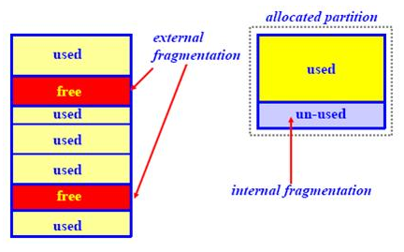
Fragmentation

Slide 27
Fragmentation (Cont.)
Reduce external fragmentation by compaction
Shuffle memory contents to place all free memory together in one large block
Compaction is possible only if relocation is dynamic, and is done at execution time
I/O problem
Latch job in memory while it is involved in I/O
Do I/O only into OS buffers
Now consider that backing store has same fragmentation problems

Slide 28
PAGING
Physical address space of a process can be noncontiguous; process is allocated physical memory whenever the latter is available
Avoids external fragmentation
Avoids problem of varying sized memory chunks
Divide physical memory into fixed-sized blocks called frames
Size is power of 2, between 512 bytes and 16 Mbytes.
Divide logical memory into blocks of same size called pages
Keep track of all free frames
To run a program of size N pages, need to find N free frames and load program
Set up a page table to translate logical to physical addresses
Backing store likewise split into pages
Still have Internal fragmentation

Slide 29
PAGING (Cont.)
Calculating internal fragmentation
Given:
Page size = 2,048 bytes
Process size = 72,766 bytes
35 pages + 1,086 bytes
Calculate:
Internal fragmentation of 2,048 - 1,086 = 962 bytes
Worst case fragmentation = 1 frame – 1 byte
On average fragmentation = 1 / 2 frame size
Process view and physical memory now very different
By implementation process can only access its own memory

Slide 30
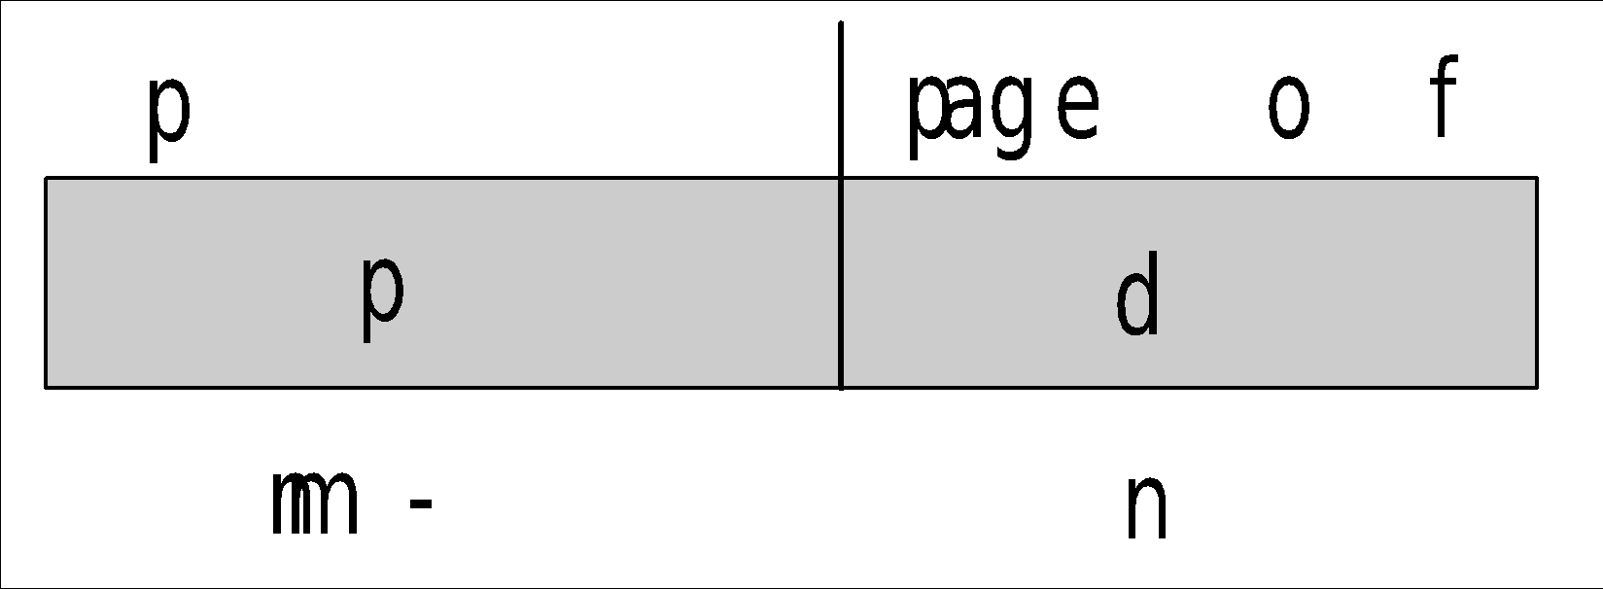
Address Translation Scheme
Address generated by CPU is divided into:
Page number (p) – used as an index into a page table which contains base address of each page in physical memory
Page offset (d) – combined with base address to define the physical memory address that is sent to the memory unit
For given logical address space 2^{m} and page size 2^{n}

Slide 31
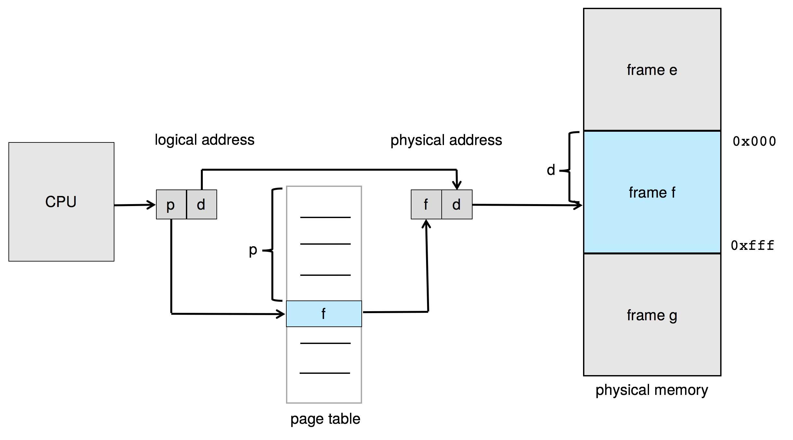
PAGING HARDWARE

Slide 32
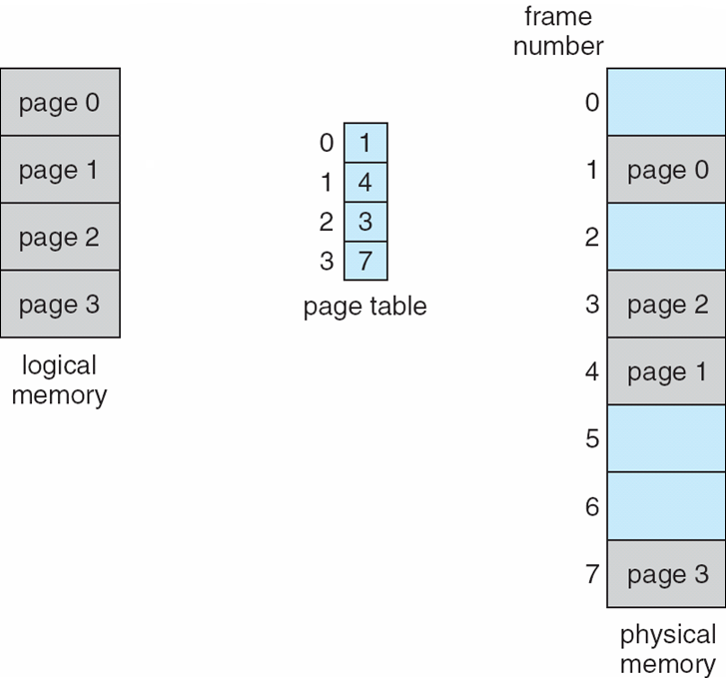
Paging Model of Logical and Physical Memory

Slide 33
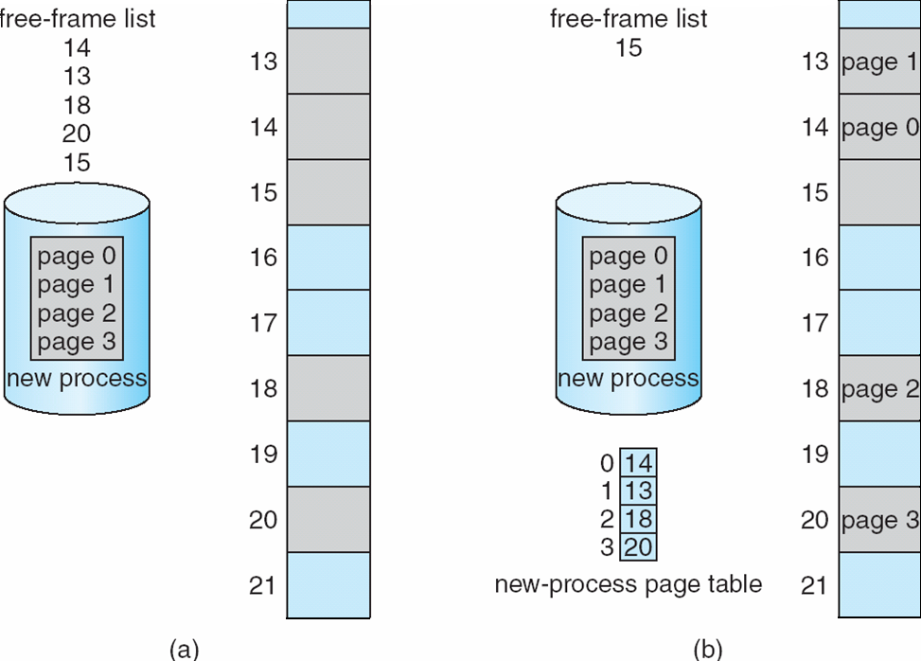
FREE FRAMES
Before allocation
After allocation

Slide 34
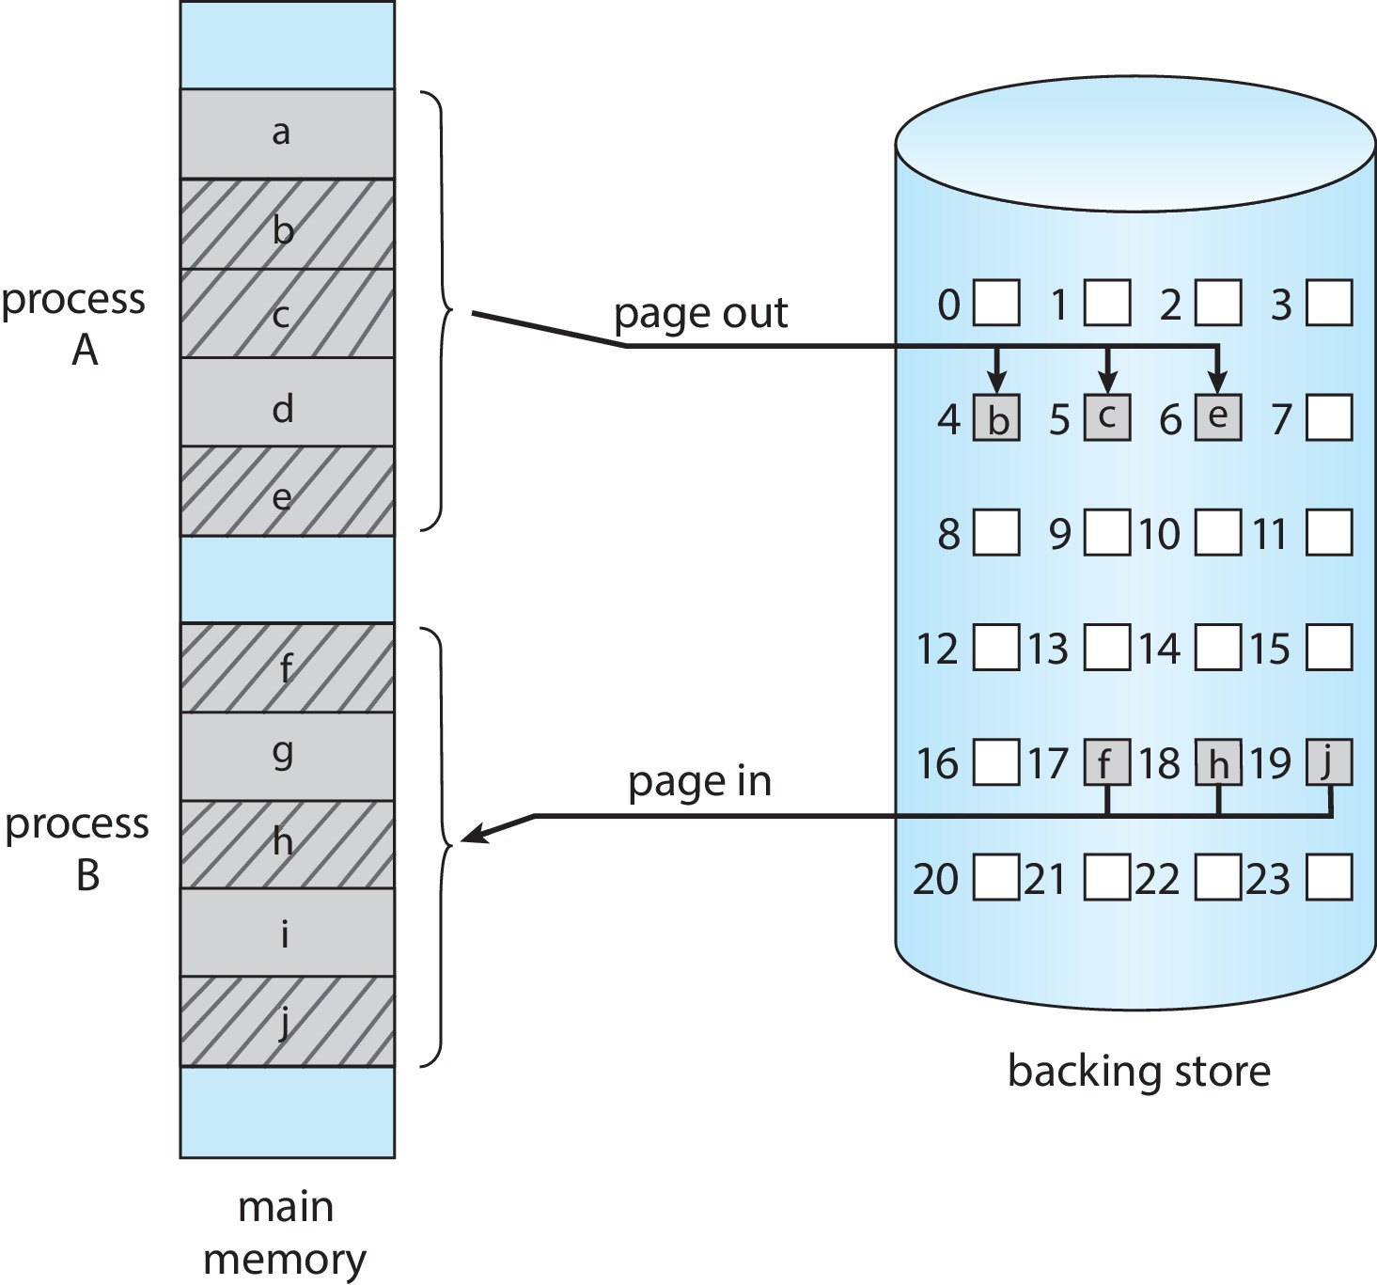
SWAPPING WITH PAGING

Slide 35
Paging Numerical-1
Assuming a 1-KB page size, what are the page numbers and offsets for the following address references (provided as decimal numbers):
a. 3085
b. 42095
c. 215201
d. 650000
e. 2000001

Slide 36
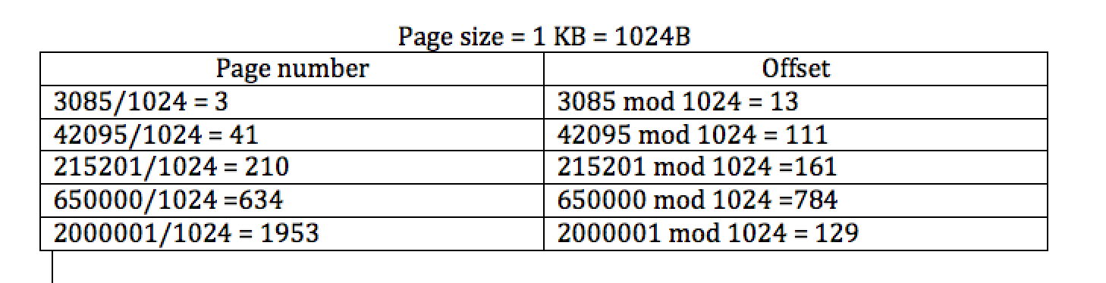
Page Numerical-1 (Solution2)
3085/1024= 3.0126953125
3 = pages
0.126953125 * 1024 = 13

Slide 37
Paging Numerical-2
Consider a logical address space (LAS) of 32 pages with 1024 words per page; mapped onto a physical memory of 16 frames.
How many bits are required in the logical address?
How many bits are required in the physical address?
Answer:
2^5 * 2^10 = 2^15 = 15 bits.
2^4 * 2^10 = 2^14 = 14 bits.

Slide 38
Implementation of Page Table
Page table is kept in main memory
Page-table base register (PTBR) points to the page table
Page-table length register (PTLR) indicates size of the page table
In this scheme every data/instruction access requires two memory accesses
One for the page table and one for the data / instruction
The two-memory access problem can be solved using a special fast-lookup hardware cache called translation look-aside buffers (TLBs) (also called associative memory).

Slide 39
Translation Look-Aside Buffer
Some TLBs store address-space identifiers (ASIDs) in each TLB entry – uniquely identifies each process to provide address-space protection for that process
Otherwise need to flush at every context switch.
TLBs typically small (64 to 1,024 entries)
On a TLB miss, value is loaded into the TLB for faster access next time
Replacement policies must be considered
Some entries can be wired down for permanent fast access

Slide 40
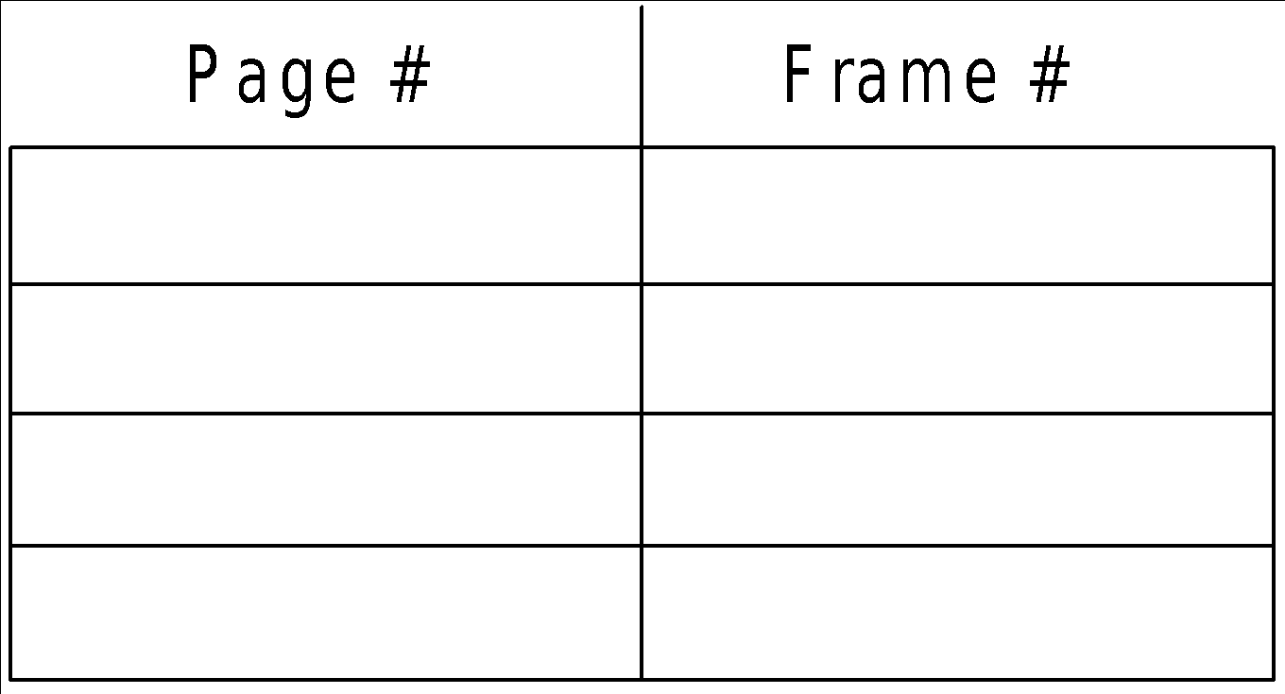
ASSOCIATIVE MEMORY
Associative memory – parallel search
Address translation (p, d)
If p is in associative register, get frame # out
Otherwise get frame # from page table in memory

Slide 41
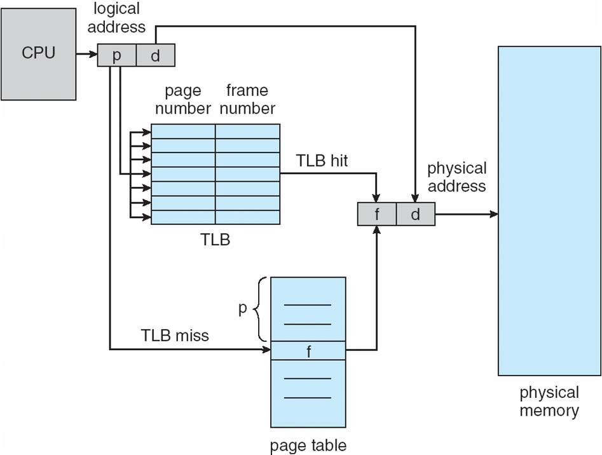
Paging Hardware With TLB

Slide 42
Hit ratio
Hit ratio = α
Hit ratio – percentage of times that a page number is found in the TLB
An 80% hit ratio means that we find the desired page number in the TLB 80% of the time.
Suppose that 10 nanoseconds to access memory.
If we find the desired page in TLB then a mapped-memory access take 10 ns
Otherwise, we need two memory access, so it is 20 ns

Slide 43
Effective Access Time
Effective Access Time (EAT)
EAT= α x memory access time (hit) + fail x memory access time (failed)

Slide 44
Effective Access Time (Cont.)
Consider α = 80%, 100ns for memory access
EAT = 0.80 x 100 + 0.20 x (100+100) = 120ns
Consider more realistic hit ratio -> α = 99% , 100ns for memory access
EAT = 0.99 x 100 + 0.01 x (100+100) = 101ns

Slide 45
EAT Numerical
Consider a paging system with the page table stored in memory.
If a memory reference takes 200 nanoseconds, how long does a paged memory reference take?
If we add associative registers, and 75 percent of all page-table references are found in the associative registers, what is the effective memory reference time? (Assume that finding a page-table entry in the associative registers takes zero time if the entry is there.)

Slide 46
EAT Numerical (Sol)
Answer:
400 nanoseconds: 200 nanoseconds to access the page table and 200 nanoseconds to access the word in memory.
Effective access time = 0.75 × (200 nanoseconds) + 0.25 × (400 nanoseconds) = 250 nanoseconds.

Slide 47
Memory Protection
Memory protection implemented by associating protection bit with each frame to indicate if read-only or read-write access is allowed
Can also add more bits to indicate page execute-only, and so on
Valid-invalid bit attached to each entry in the page table:
“valid” indicates that the associated page is in the process’ logical address space, and is thus a legal page
“invalid” indicates that the page is not in the process’ logical address space
Or use page-table length register (PTLR)

Slide 48
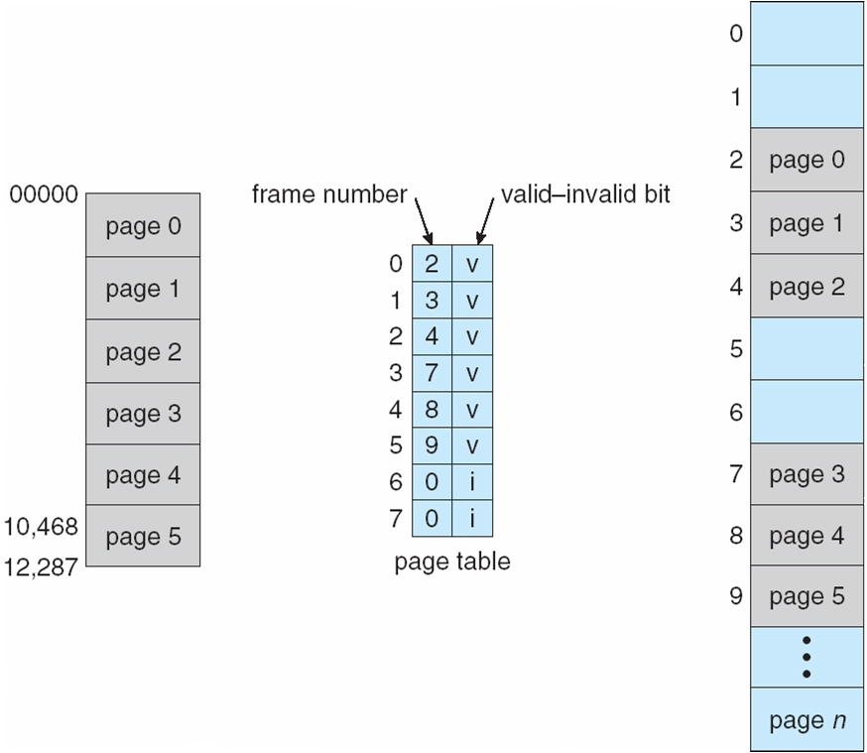
Valid (v) or Invalid (i) Bit In A Page Table

Slide 49
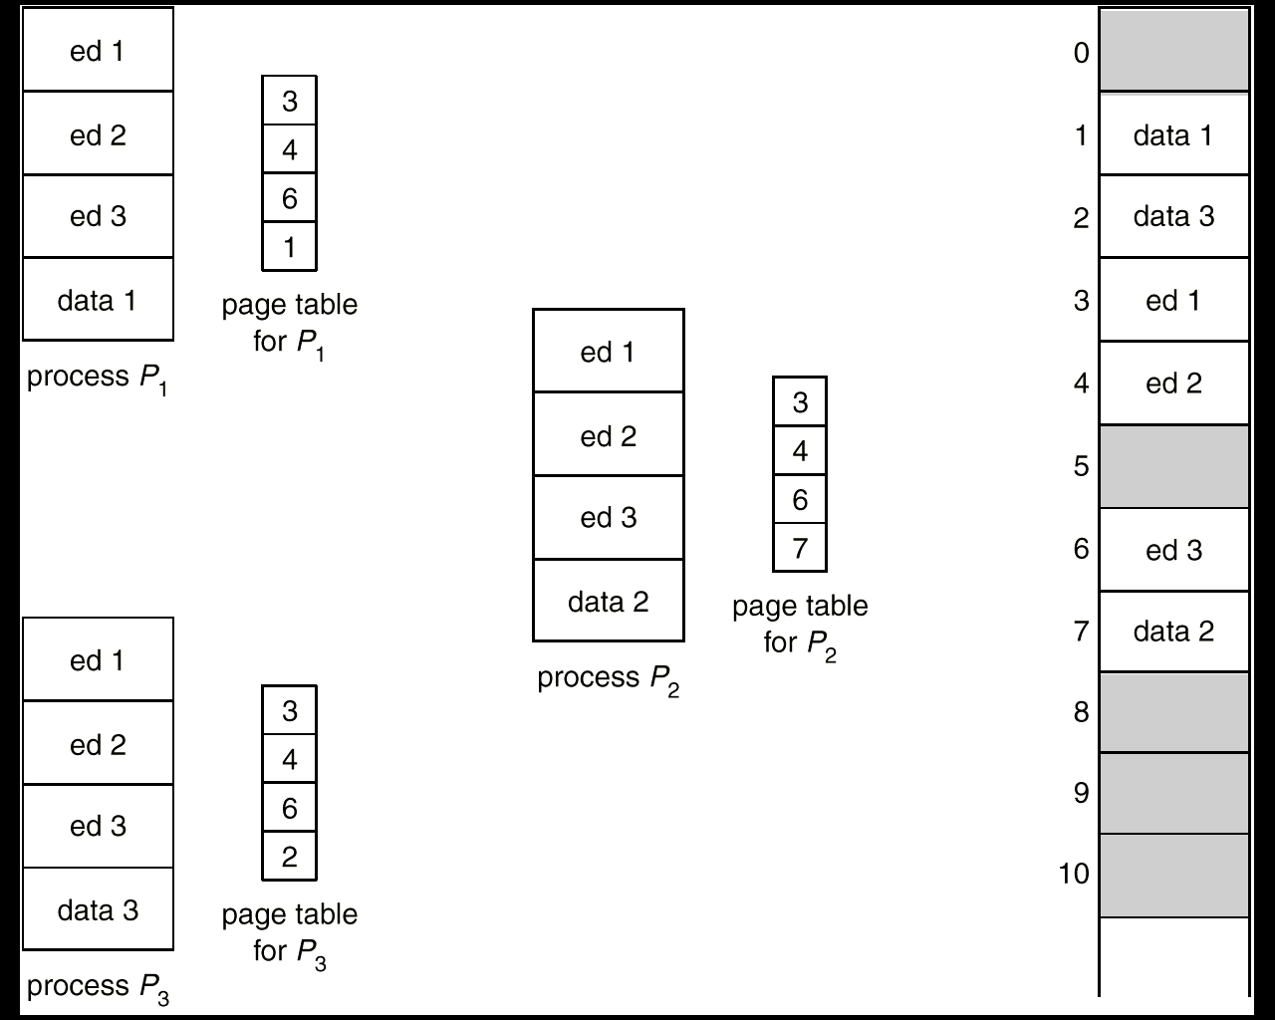
SHARED PAGES
Shared code
Read-only (reentrant) code shared among processes
Shared code appeared in same location in the physical address space
Private code and data
Each process keeps a separate copy of the code and data, (e.g., stack).
Private page can appear anywhere in the physical address space.
Copy on write
Pages may be initially shared upon a fork
They will be duplicated upon a write

Slide 50
Structure of the Page Table
Memory structures for paging can get huge using straightforward methods
Consider a 32-bit logical address space as on modern computers
Page size of 4 KB (2¹²)
Page table would have 1 million entries (2³² / 2¹²)
If each entry is 4 bytes -> 4 MB of physical address space / memory for page table alone
That amount of memory used to cost a lot
Don’t want to allocate that contiguously in main memory

Slide 51
Structure of the Page Table
Hierarchical Paging
Hashed Page Tables
Inverted Page Tables

Slide 52
Hierarchical Page Tables
Break up the logical address space into multiple page tables
A simple technique is a two-level page table
We then page the page table

Slide 53
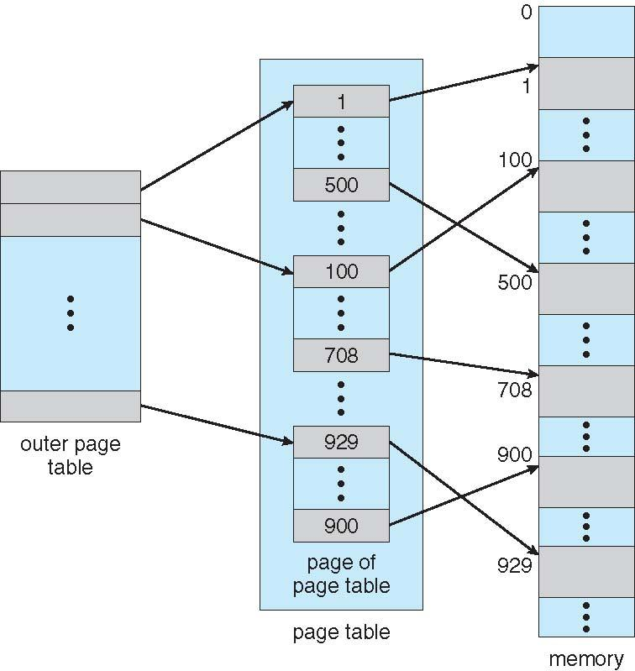
Two-Level Page-Table Scheme

Slide 54
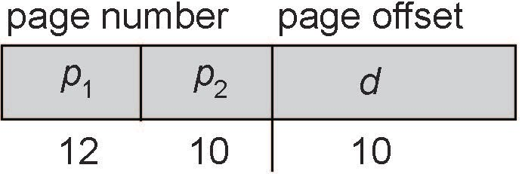
Two-Level Paging Example
A logical address (on 32-bit machine with 1K page size) is divided into:
a page number consisting of 22 bits
a page offset consisting of 10 bits
Since the page table is paged, the page number is further divided into:
a 12-bit page number
a 10-bit page offset
Thus, a logical address is as follows:
where p₁ is an index into the outer page table, and p₂ is the displacement within the page of the inner page table
Known as forward-mapped page table

Slide 55
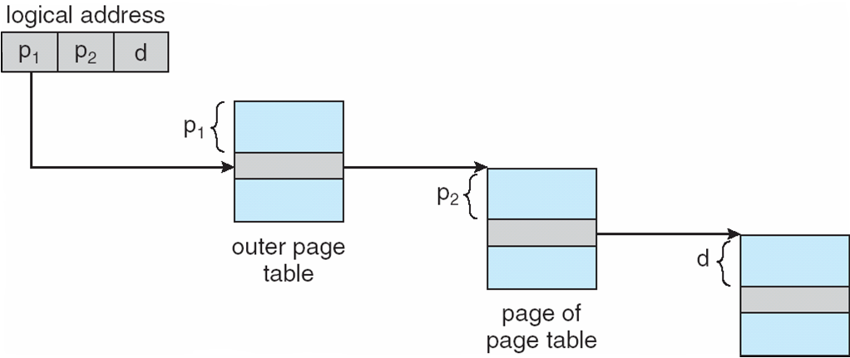
Address-Translation Scheme

Slide 56
64-bit Logical Address Space
Even two-level paging scheme not sufficient.
If page size is 4 KB (2¹²)
Then page table has 2⁵² entries
If two level scheme, inner page tables could be 2¹⁰ 4-byte entries
One solution is to add a 2nd outer page table
But in the following example the 2nd outer page table is still 2³⁴ bytes in size
And possibly 4 memory access to get to one physical memory location

Slide 57
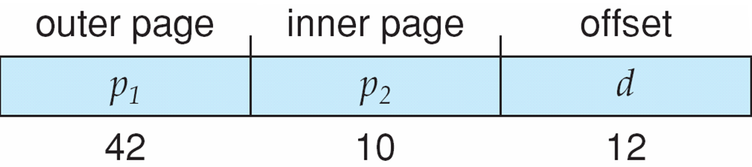
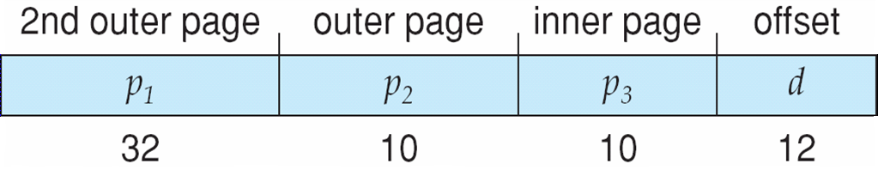
Three-level Paging Scheme

Slide 58
Hashed Page Tables
Common in address spaces > 32 bits
The virtual page number is hashed into a page table
This page table contains a chain of elements hashing to the same location
Each element contains (1) the virtual page number (2) the value of the mapped page frame (3) a pointer to the next element
Virtual page numbers are compared in this chain searching for a match
If a match is found, the corresponding physical frame is extracted
Variation for 64-bit addresses is clustered page tables
Similar to hashed but each entry refers to several pages (such as 16) rather than 1
Especially useful for sparse address spaces (where memory references are non-contiguous and scattered)

Slide 59
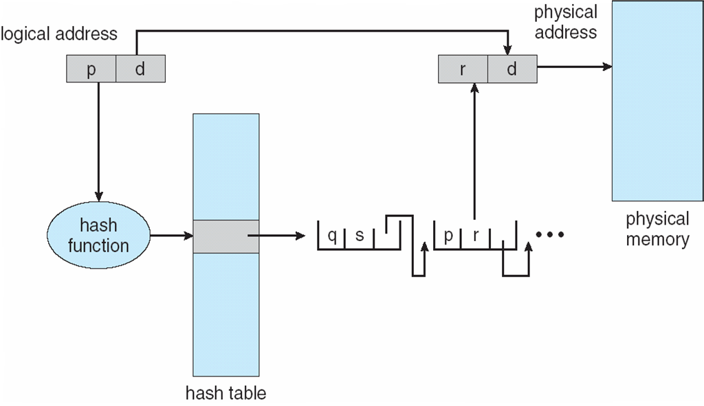
Hashed Page Table

Slide 60
Inverted Page Table
Rather than each process having a page table and keeping track of all possible logical pages, track all physical pages
Entry consists of the virtual address of the page stored in that real memory location, with information about the process that owns that page
Decreases memory needed to store each page table, but increases time needed to search the table when a page reference occurs
Use hash table to limit the search to one — or at most a few — page-table entries
TLB can accelerate access

Slide 61
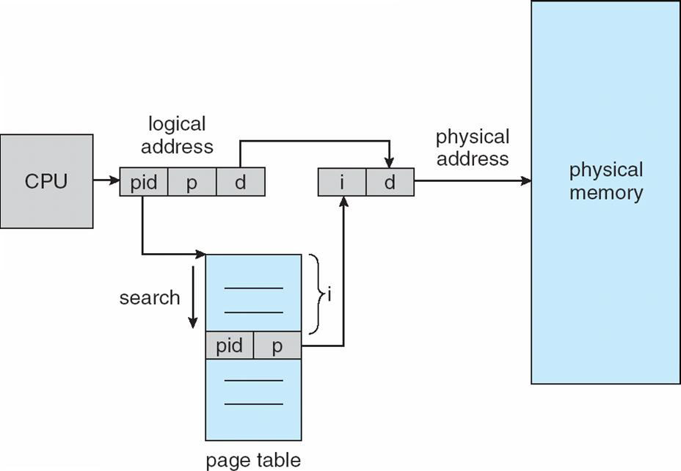
Inverted Page Table Architecture

Slide 62
THANK YOU!

